Slide 1
Extracting information from text
NLPP §7
Adapted from: http://www.tulane.edu/~howard/NLP/

Slide 2
Intro
For any given question, it's likely that someone has written the answer down somewhere.
The amount of natural language text that is available in electronic form is truly staggering, and is increasing every day.
However, the complexity of natural language can make it very difficult to access the information in that text.
2

Slide 3
Intro, cont.
The state of the art in NLP is still a long way from being able to build general-purpose representations of meaning from unrestricted text.
If we instead focus our efforts on a limited set of questions or "entity relations," such as
"where are different facilities located," or
"who is employed by what company,"
we can make significant progress.
3

Slide 4
Goals of chapter
The goal of this chapter is to answer the following questions:
How can we build a system that extracts structured data, such as tables, from unstructured text?
What are some robust methods for identifying the entities and relationships described in a text?
Which corpora are appropriate for this work, and how do we use them for training and evaluating our models?
Along the way, we'll apply techniques from the last two chapters to the problems of
chunking and
named-entity recognition.
4

Slide 5
Text Snippet
The fourth Wells account moving to another agency is the packaged paper-products division of Georgia-Pacific Corp., which arrived at Wells only last fall. Like Hertz and the History Channel, it is also leaving for an Omnicom-owned agency, the BBDO South unit of BBDO Worldwide. BBDO South in Atlanta, which handles corporate advertising for Georgia-Pacific, will assume additional duties for brands like Angel Soft toilet tissue and Sparkle paper towels, said Ken Haldin, a spokesman for Georgia-Pacific in Atlanta.

Slide 6
Text Snippet
The fourth Wells account moving to another agency is the packaged paper-products division of Georgia-Pacific Corp., which arrived at Wells only last fall. Like Hertz and the History Channel, it is also leaving for an Omnicom-owned agency, the BBDO South unit of BBDO Worldwide. BBDO South in Atlanta, which handles corporate advertising for Georgia-Pacific, will assume additional duties for brands like Angel Soft toilet tissue and Sparkle paper towels, said Ken Haldin, a spokesman for Georgia-Pacific in Atlanta.

Slide 7
Structured data
OrgName | LocationName
Omnicom | New York
DDB Needham | New York
Kaplan Thaler Group | New York
BBDO South | Atlanta
Georgia-Pacific | Atlanta
Store info in Python as list of tuples (entity, relation, entity),
relations = [(‘Omnicom’,’IN’,’New York’), ... ]
then the question "Which organizations operate in Atlanta?"
could be translated as follows:
>>> print [org for (e1, rel, e2) if rel=='IN' and e2==‘Atlanta']
>>> print [ e1 for (e1,rel,e2) in relations if rel=='IN' and e2=='Atlanta' ]
['BBDO South', 'Georgia-Pacific']
5

Slide 8
For example, given a document that indicates that the company Georgia-Pacific is located in Atlanta, it might generate the tuple:
([ORG: 'Georgia-Pacific'] 'in' [LOC: 'Atlanta'])

Slide 9
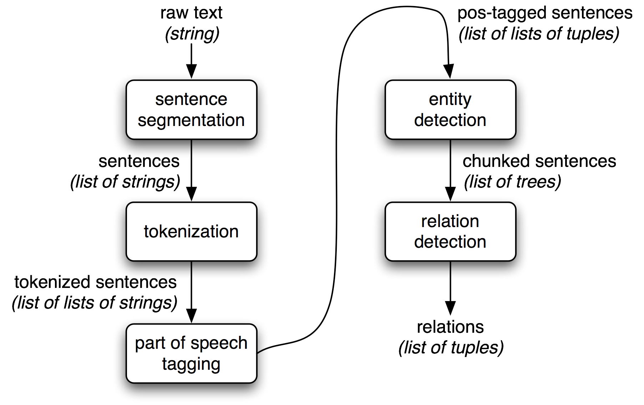
Workflow for info extraction
Figure 7-1. Simple pipeline architecture for an information extraction system. This system takes the raw text of a document as its input, and generates a list of (entity, relation, entity) tuples as its output. For example, given a document that indicates that the company Georgia-Pacific is located in Atlanta, it might generate the tuple ([ORG: 'Georgia-Pacific'] 'in' [LOC: 'Atlanta']).
6
Notes:
Figure 7.1

Slide 10
Info extraction steps 1-3
To perform the first three tasks, we can define a function that simply connects together NLTK’s default sentence segmenter (1), word tokenizer (2), and part-of-speech tagger (3):
>>> def ie_preprocess(document):
... sentences = nltk.sent_tokenize(document) #1
... sentences = [nltk.word_tokenize(sent) for sent in sentences] #2
... sentences = [nltk.pos_tag(sent) for sent in sentences] #3
4

Slide 11
Info extraction steps 4-5
named entity recognition — segment and label the entities that might participate in interesting relations with one another. Typically these will be:
definite noun phrases such as “the knights who say ‘ni’ ”
proper names such as Monty Python
indefinite nouns such as every student or cats
relation extraction — search for specific patterns between pairs of entities that occur near one another in the text, and use those patterns to build tuples recording the relationships between the entities

Slide 12
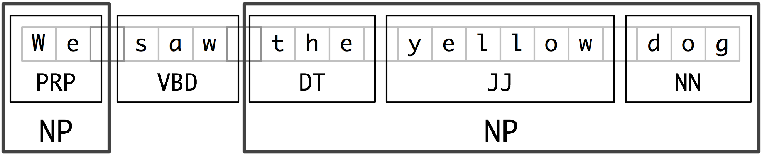
7.2 Chunking
chunking — segment and label multi-token sequence
“chunk”
7
Notes:
Figure 7.2: Segmentation and Labeling at both the Token and Chunk Levels

Slide 13
Noun phrase chunking
Noun phrase chunking or NP-chunking — search for chunks according to individual noun phrases.
e.g. Wall Street Journal text with NP-chunks marked using brackets:
[ The/DT market/NN ] for/IN [ system-management/NN software/NN ] for/IN [ Digital/NNP ] [ 's/POS hardware/NN ] is/VBZ fragmented/JJ enough/RB that/IN [ a/DT giant/NN ] such/JJ as/IN [ Computer/NNP Associates/NNPS ] should/MD do/VB well/RB there/RB ./.
8
Notes:
NP-chunks do not to contain other NP-chunks, so they are different from Noun Phrases.

Slide 14
Chunk grammar
An NP chunk should be formed whenever the chunker finds an optional determiner (DT) followed by any number of adjectives (JJ) and then a noun (NN):
>>> grammar = "NP: {<DT>?<JJ>*<NN>}"
9
Notes:
we define a simple grammar with a simple regex rule

Slide 15
Tag Patterns
A RegexpChunkRule uses a modified version of regular expression patterns, called “tag patterns”. Tag patterns are used to match sequences of tags. Examples of tag patterns are:
r'(<DT>|<JJ>|<NN>)+'
r'<NN>+'
r'<NN.*>'
The differences between regular expression patterns and tag patterns are:
In tag patterns, '<' and '>' act as parentheses; so '<NN>+' matches one or more repetitions of '<NN>', not '<NN' followed by one or more repetitions of '>'.
Whitespace in tag patterns is ignored. So '<DT> | <NN>' is equivalant to '<DT>|<NN>'
In tag patterns, '.' is equivalant to '[^{}<>]'; so '<NN.*>' matches any single tag starting with 'NN'.
http://www.nltk.org/api/nltk.chunk.html

Slide 16
Example 7-1
>>> sentence = [("the", "DT"), ("little", "JJ"),
... ("yellow", "JJ"),("dog", "NN"),
... (“barked”, "VBD"), ("at", "IN"),
... (“the”, "DT"), ("cat", "NN")]
>>> grammar = "NP: {<DT>?<JJ>*<NN>}"
>>> cp = nltk.RegexpParser(grammar)
>>> result = cp.parse(sentence)
>>> print result
(S
(NP the/DT little/JJ yellow/JJ dog/NN)
barked/VBD
at/IN
(NP the/DT cat/NN)
10
Notes:
the result is a tree which we can draw

Slide 17
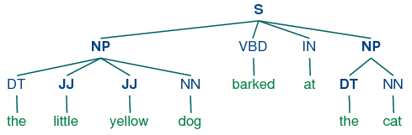
result.draw()
11

Slide 18
RegexpParser
RegexpParser chunker begins with a flat structure in which no tokens are chunked.
The chunking rules are applied in turn, successively updating the chunk structure.
Once all of the rules have been invoked, the resulting chunk structure is returned.
12

Slide 19
Example 7-2
grammar = r""" NP: {<DT|PP\$>?<JJ>*<NN>}
{<NNP>+} # chunk sequences of proper nouns"""
cp = nltk.RegexpParser(grammar) sentence = [("Rapunzel", "NNP"), ("let", "VBD"), ("down", "RP"),
("her", "PP$"), ("long", "JJ"), ("golden", "JJ"), ("hair", "NN")]
>>> print cp.parse(sentence)
(S (NP Rapunzel/NNP) let/VBD down/RP (NP her/PP$ long/JJ golden/JJ hair/NN))
Notes:
DT=determiner/possessive, adjectives, nouns
PP$ = possessive pronoun, e.g. my, his

Slide 20
Chinking
Sometimes it is easier to define what we want to exclude from a chunk.
We can define a chink to be a sequence of tokens that is not included in a chunk. In the following example, barked/VBD at/IN is a chink:
[ the/DT little/JJ yellow/JJ dog/NN ] barked/VBD at/IN [ the/DT cat/NN ]
13

Slide 21
More chinking
Possibilities:
If the matching sequence of tokens spans an entire chunk, then the whole chunk is removed;
if the sequence of tokens appears in the middle of the chunk, these tokens are removed, leaving two chunks where there was only one before.
If the sequence is at the periphery of the chunk, these tokens are removed, and a smaller chunk remains.
14

Slide 22
Options in a table
` ` | Entire chunk | Middle of a chunk | End of a chunk
Input | [a/DT little/JJ dog/NN] | [a/DT little/JJ dog/NN] | [a/DT little/JJ dog/NN]
Operation | Chink "DT JJ NN" | Chink "JJ" | Chink "NN"
Pattern | }DT JJ NN{ | }JJ{ | }NN{
Output | a/DT little/JJ dog/NN | [a/DT] little/JJ [dog/NN] | [a/DT little/JJ] dog/NN
15
Notes:
Table 7.3: Three chinking rules applied to the same chunk

Slide 23
Example 7-3: Chinking
grammar = r"""
NP:
{<.*>+} # Chunk everything
}<VBD|IN>+{ # Chink sequences of VBD and IN """
sentence = [("the", "DT"), ("little", "JJ"), ("yellow", "JJ"), ("dog", "NN"), ("barked", "VBD"), ("at", "IN"), ("the", "DT"), ("cat", "NN")]
cp = nltk.RegexpParser(grammar)
>>> print cp.parse(sentence)
(S (NP the/DT little/JJ yellow/JJ dog/NN) barked/VBD at/IN (NP the/DT cat/NN))

Slide 24
Representing chunks
Chunk structures can be represented using either tags or trees.
The most widespread file representation uses IOB tags.
In this scheme, each token is tagged with one of three special chunk tags, I (inside), O (outside), or B (begin).
A token is tagged as B if it marks the beginning of a chunk.
Subsequent tokens within the chunk are tagged I.
All other tokens are tagged O.
The B and I tags are suffixed with the chunk type, e.g., B-NP, I- NP.

Slide 25
Workflow for info extraction
16
Notes:
Figure 7.1

Slide 26
Hierarchical structure
Chunks can be represented as trees
Hierarchy from tags
IOB tags
Inside, Outside, Begin
IOB tags for example:
We PRP B-NP
saw VBD O
the DT B-NP
little JJ I-NP
yellow JJ I-NP
dog NN I-NP
18

Slide 27
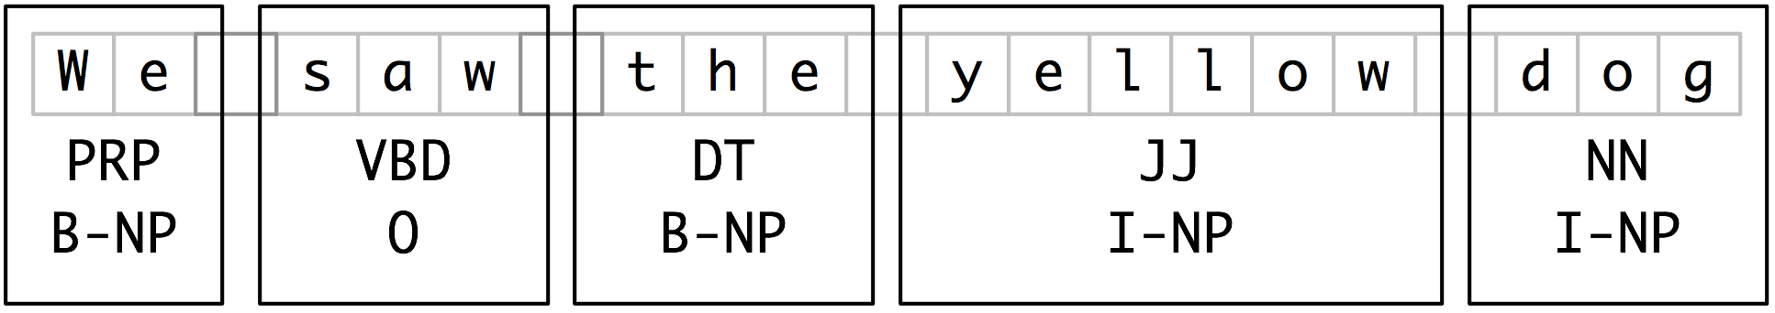
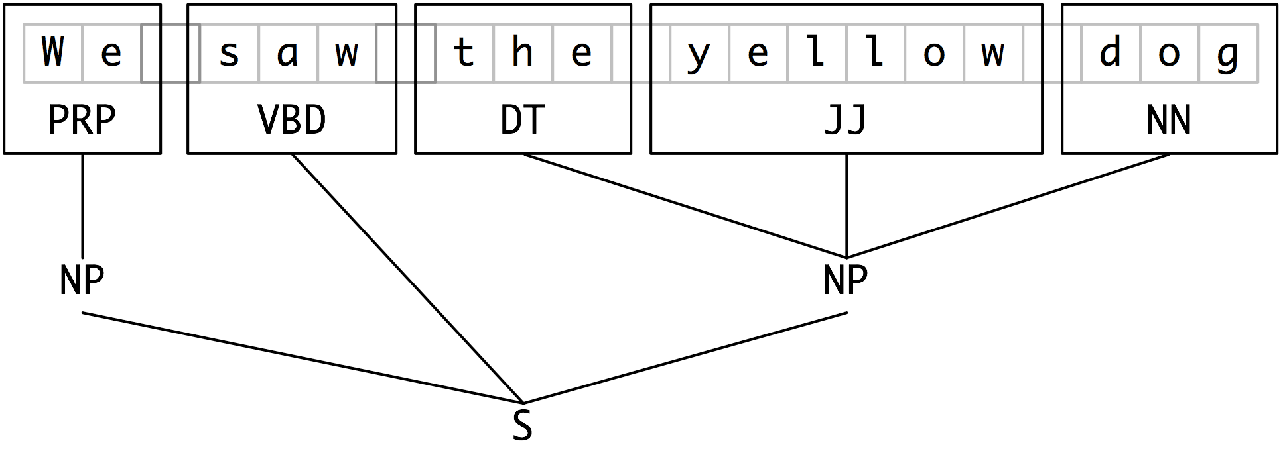
Results
19
Notes:
Figure 7.3: Tag Representation of Chunk Structures, Figure 7.4: Tree Representation of Chunk Structures

Slide 28
Developing & evaluating chunkers
NLPP 7.3

Slide 29
Overview
Need a corpus that is already chunked to evaluate a new chunker.
CoNLL-2000 Chunking Corpus from Wall Street Journal
Evaluation
Training
21

Slide 30
CoNLL-2000 Chunking Corpus
CoNLL = Conference on Natural Language Learning.
CoNLL-2000 held in Lisbon, Portugal
The CoNLL-2000 Chunking Corpus contains 270k words of Wall Street Journal text, divi- ded into “train” and “test” portions, annotated with part-of-speech tags and chunk tags in the IOB format.
We can access the data using nltk.corpus.conll2000

Slide 31
CoNLL-2000
Here is an example that reads the 100th sentence of the “train” portion of the corpus:
>>> from nltk.corpus import conll2000 >>> print conll2000.chunked_sents('train.txt')[99]
(S (PP Over/IN) (NP a/DT cup/NN) (PP of/IN) (NP coffee/NN) ,/, (NP Mr./NNP Stone/NNP)
(VP told/VBD) (NP his/PRP$ story/NN)
./.)

Slide 32
chunk.conllstr2tree()
see example p271-conllstr2tree.py

Slide 33
Establish baseline
Now that we can access a chunked corpus, we can evaluate chunkers.
Establish baseline for the trivial chunk parser cp that creates no chunks
>>> from nltk.corpus import conll2000 >>> cp = nltk.RegexpParser("") >>> test_sents = conll2000.chunked_sents('test.txt', chunk_types=['NP'])
>>> print cp.evaluate(test_sents) ChunkParse score:
IOB Accuracy: 43.4%
Precision: 0.0%
Recall: 0.0%
F-Measure: 0.0%
Notes:
More than 1/3rd of the words are tagged with 0, i.e. not in an NP chunk. However, since our tagger did not find any chunks, its precision, recall, and F-measure are all zero.

Slide 34
Simple evaluation
Now let’s try a naive regular expression chunker that looks for tags beginning with letters that are characteristic of noun phrase tags (e.g., CD, DT, and JJ).
>>> grammar = r"NP: {<[CDJNP].*>+}"
>>> cp = nltk.RegexpParser(grammar)
>>> print cp.evaluate(test_sents)
ChunkParse score:
IOB Accuracy: 87.7%
Precision: 70.6%
Recall: 67.8%
F-Measure: 69.2%

Slide 35
Recursion in ling structure
NLPP 7.4

Slide 36
Nested structure
We have looked at trees, but they are different from normal linguistic trees.
NP chunks do not contain NP chunks, ie. they are nor recursive.
They do not go arbitrarily deep.
23
Notes:
(Example on board.)

Slide 37
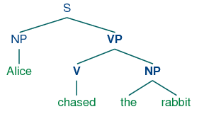
Trees
(S
(NP Alice)
(VP
(V chased)
(NP
(Det the)
(N rabbit))))
24

Slide 38
Trees in NLTK
A tree is created in NLTK by giving a node label and a list of children:
>>> tree1 = nltk.Tree('NP', ['Alice'])
>>> print tree1
(NP Alice)
>>> tree2 = nltk.Tree('NP', ['the', 'rabbit'])
>>> print tree2
(NP the rabbit)
They can be incorporated into successively larger trees as follows:
>>> tree3 = nltk.Tree('VP', ['chased', tree2])
>>> tree4 = nltk.Tree('S', [tree1, tree3])
>>> print tree4
(S (NP Alice) (VP chased (NP the rabbit)))
25

Slide 39
Tree traversal
def traverse(t):
try:
t.node
except AttributeError:
print t,
else:
# Now we know that t.node is defined
print '(', t.node,
for child in t:
traverse(child)
print ')',
>>> t = nltk.Tree('(S (NP Alice) (VP chased (NP the rabbit)))')
>>> traverse(t)
( S ( NP Alice ) ( VP chased ( NP the rabbit ) ) )
26

Slide 40
7.5 Named entity recognition

Slide 41
Remember…
Named entities are definite noun phrases that refer to specific types of individuals, such as organizations, persons, dates, and so on.

Slide 42
More named entities
NE Type | Examples
ORGANIZATION | Georgia-Pacific Corp., WHO
PERSON | Eddy Bonte, President Obama
LOCATION | Murray River, Mount Everest
DATE | June, 2008-06-29
TIME | two fifty a m, 1:30 p.m.
MONEY | 175 million Canadian Dollars, GBP 10.40
PERCENT | twenty pct, 18.75 %
FACILITY | Washington Monument, Stonehenge
GPE | South East Asia, Midlothian
28

Slide 43
Overview
named entity recognition (NER) — identify all textual mentions of a named entity (NE):
Identify boundaries of a NE;
Identify its type.
Classifiers are good at this.
29

Slide 44
7.6 Relation extraction
Once named entities have been identified in a text, we then want to extract the relations that exist between them.
We will typically look for relations between specified types of a named entity.
One way of approaching this task is to initially look for all triples of the form (X, α, Y), where X and Y are named entities of the required types, and α is the string of words that intervenes between X and Y.
We can then use regular expressions to pull out just those instances of α that express the relation that we are looking for.
30

Slide 45
Relational Extraction Example
The following example searches for strings that contain the word in.
The special regexp (?!\b.+ing\b) is a negative lookahead assertion that allows us to disregard strings such as success in supervising the transition of, where in is followed by a gerund.

Slide 46
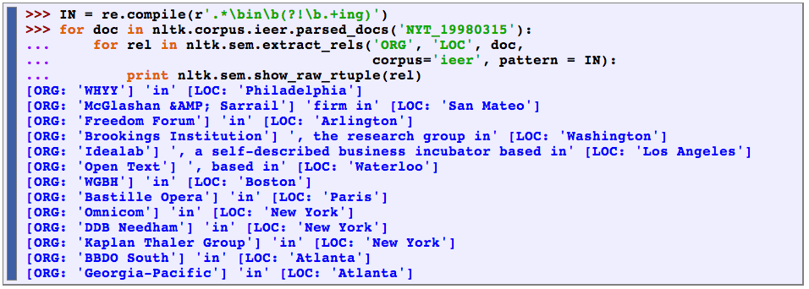
Relational Extraction Example

Slide 47
Postscript
Much of what we have described goes under the heading of text mining.
31

Slide 48
Next time
NLPP §8
Analyzing Sentence Structure

